Slide 1
Data analysis Chile's Polyester Market size
Python Intermediate (Online), Spring 2023!
Jorge Poblete
Contact: jorge.poblete.p@gmail.com

Slide 2
Context of the project
In Chile, I worked for more than 5 years in BASF, a German chemical company, focused on the polyester industry, which is a chemical product used for several industrial applications such as tank manufacturing or pipes against corrosion.
The market is composed of products that are imported from different countries and the analysis of this database is of great importance because it provides relevant information for the business such as value, price, brands, importers, producers, etc. The data processing phase is complex and time-consuming.
The process of preparation and visualization of this data set requires a very long period of effort in the analytical area. Therefore, optimizing the time and processes of obtaining, cleaning, and analyzing import data allows for obtaining strategic information for correct decision-making.

Slide 3



Goals of the project
Data analysis
Use Python as a data processing, cleaning, and visualization tool to obtain clean and reliable information that can be analyzed in graphs.
Topics understanding
OPP
File processing
Requests, Modules
Error Handling
Plotting
Tools

Slide 4
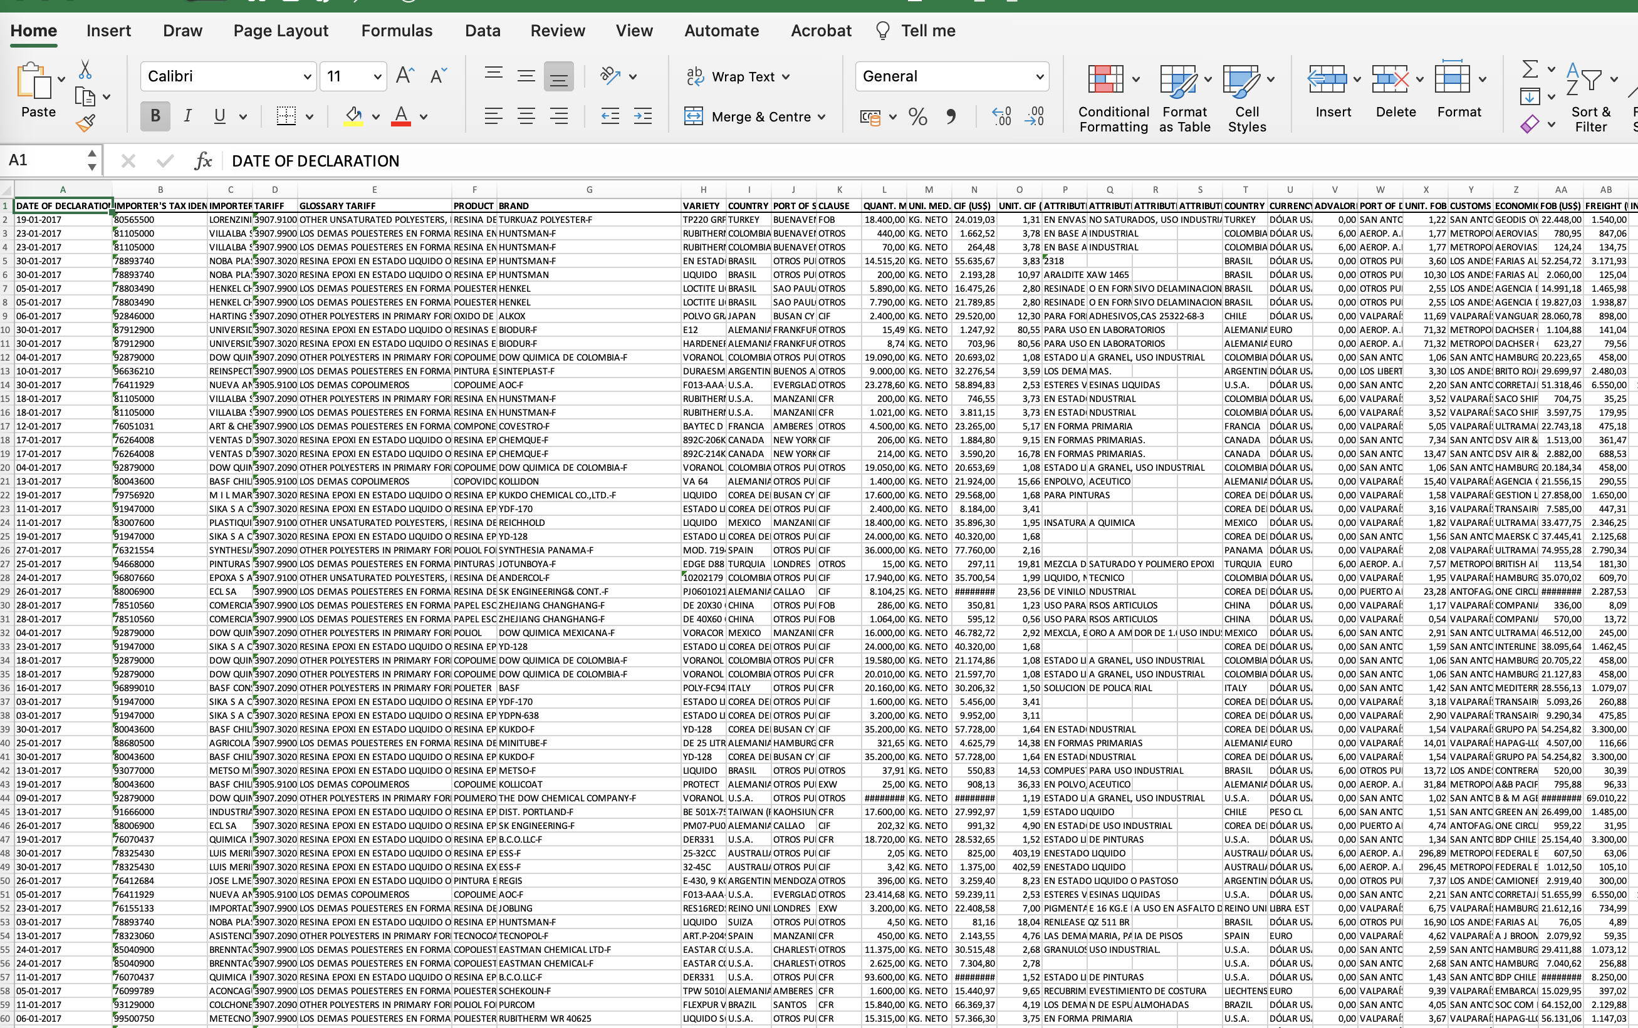
Data set
1- Information from Polyesters is found principally in Tariffs:
3907.2090
3907.9100
2- Polyester Brands in the market:
ANDERCOL
AOC
PLAQUIMET
POLIYA
REICHHOLD
SHANGHAI
TURKUAZ

Slide 5
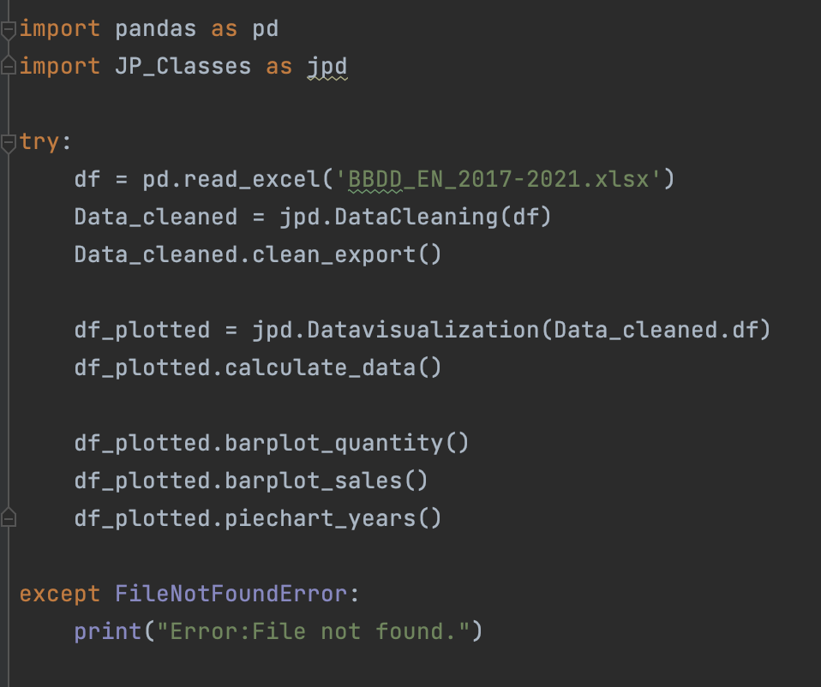
Data processing
This code reads an Excel file, and through instances, performs data cleaning with the "DataCleaning" class. Then, calculates the data metrics needed to run the second class called "Datavisualization", which generates three charts using a custom module.
Error handling: If the file is not found, an error message is displayed.
Both classes are contained in a custom module called "JP_Classes".

Slide 6
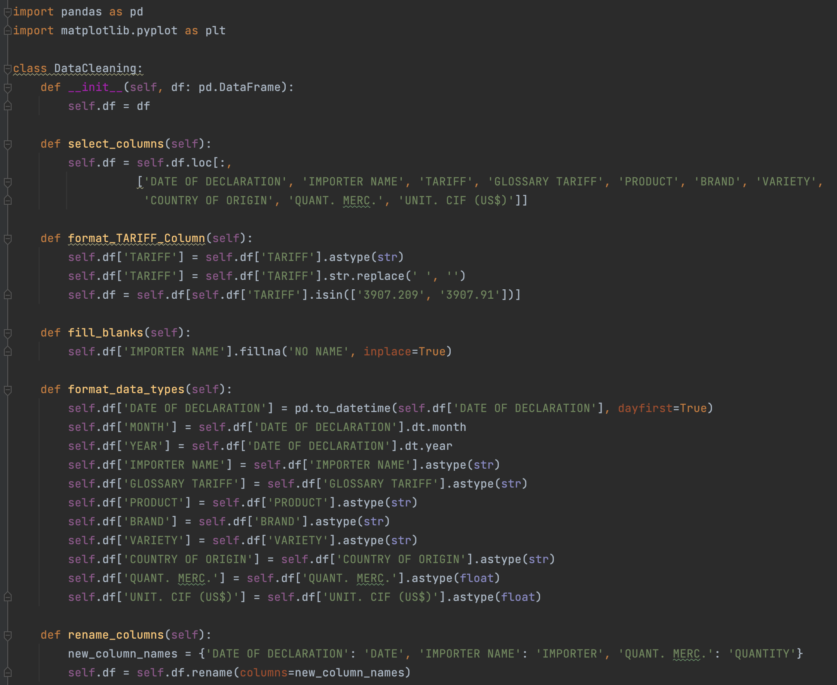
Data Cleaning
In the “DataCleaning” class the database is subjected to different filters and criteria that allow to reduce, standardize and obtain only the relevant information to be analyzed.
Methods used:
Selection only of columns of interest for the analysis.
Obtaining data from specific tariff data.
Filling empty cells
Converts various columns to their appropriate data types (e.g., string, float)
Modify column names for better readability
Obtain brands that make up the polyester market
Export to excel the final result

Slide 7
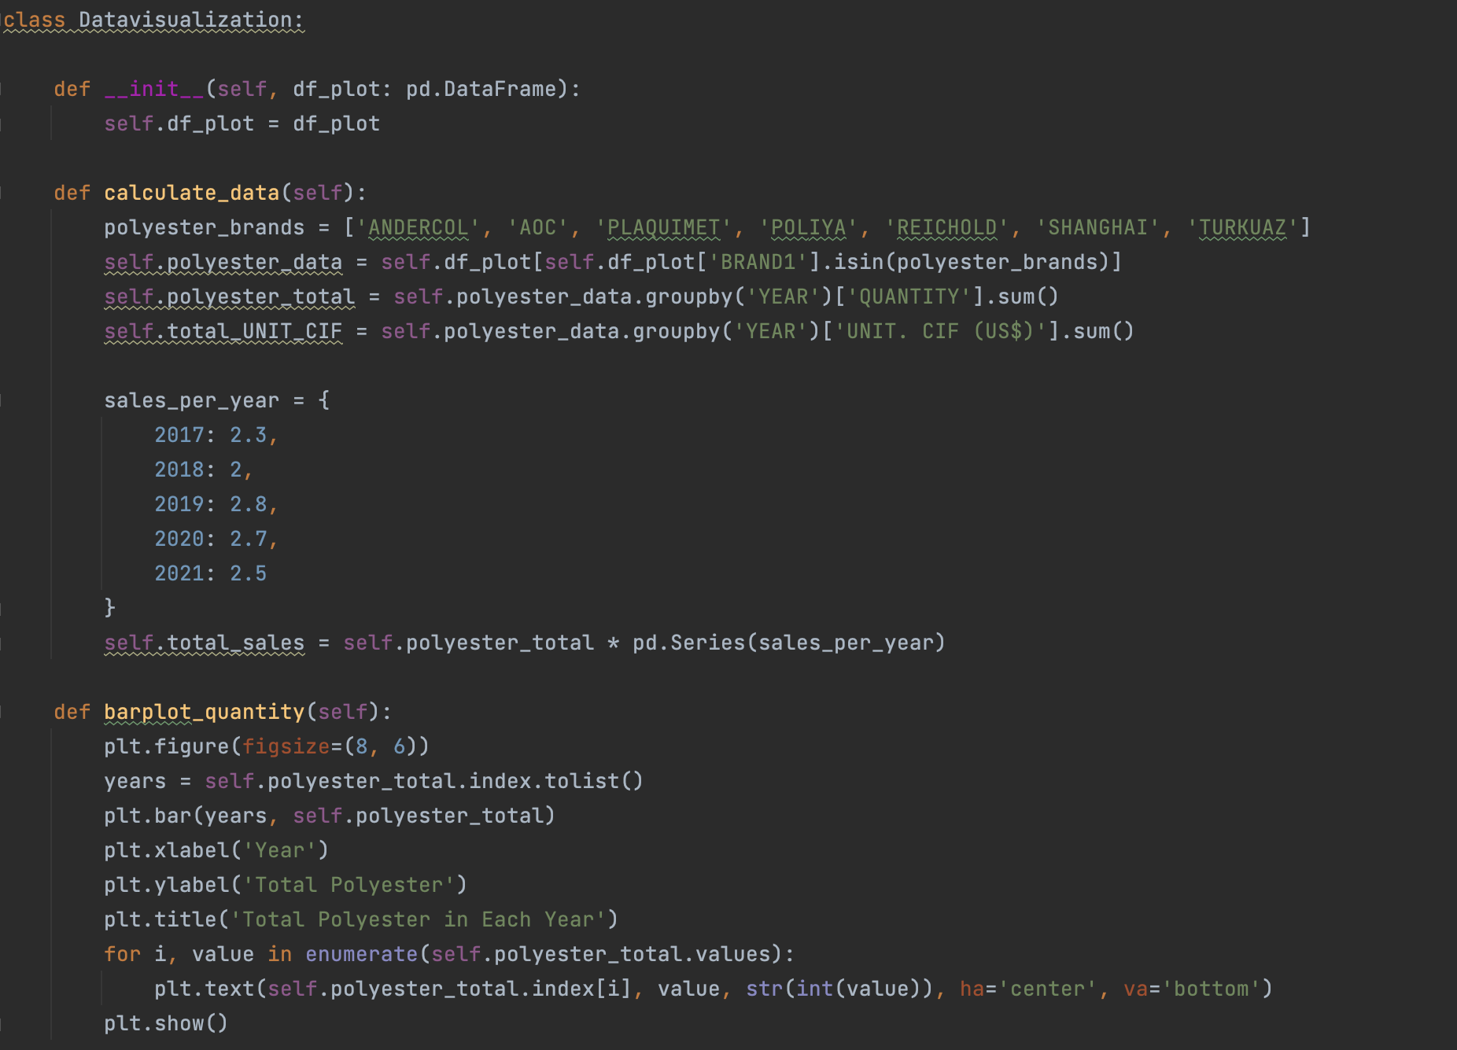
Data Visualization
The "Datavisualization" class performs data visualization tasks on a given data frame from the data cleaning stage.
Methods used:
Calculate_data: filters the DataFrame to include only specific brands, groups the data by year, and calculates total quantity, total UN. CIF (US$), and total sales.
Polyester market size: Plot quantity and sales by year.
Pie chart: Indicates the distribution of each brand in the market.

Slide 8
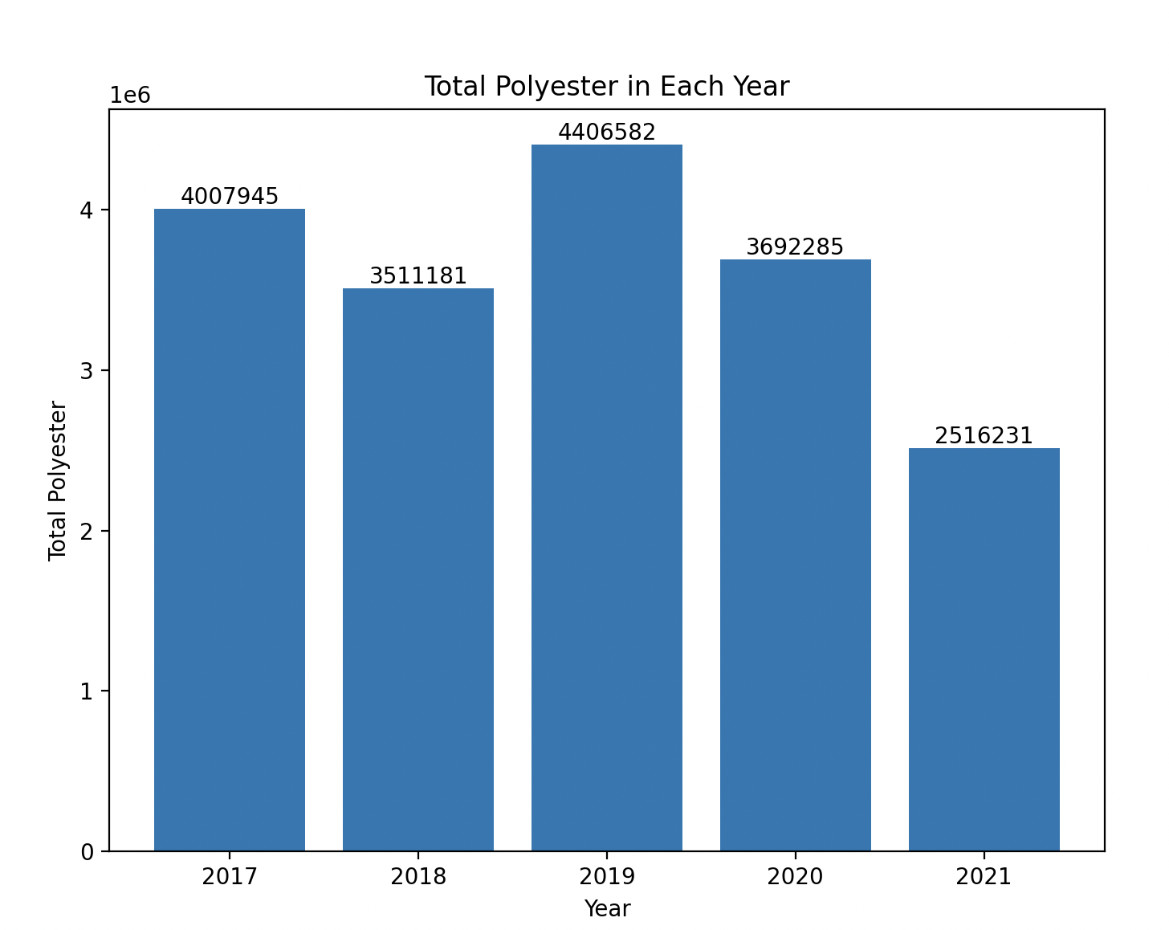
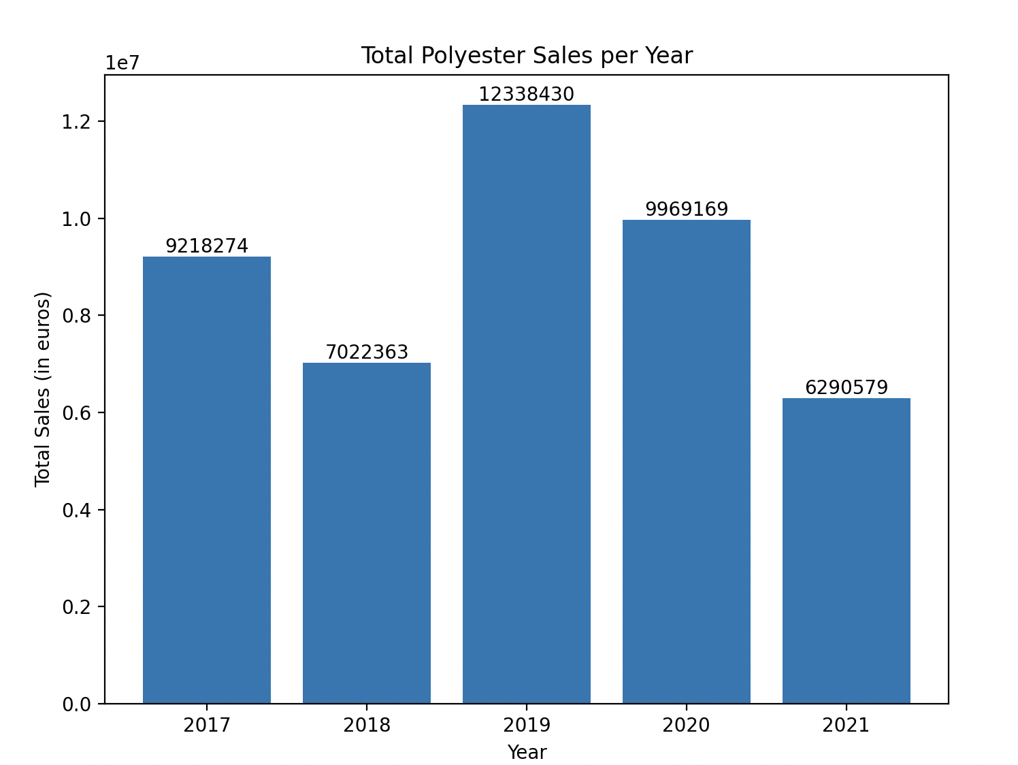
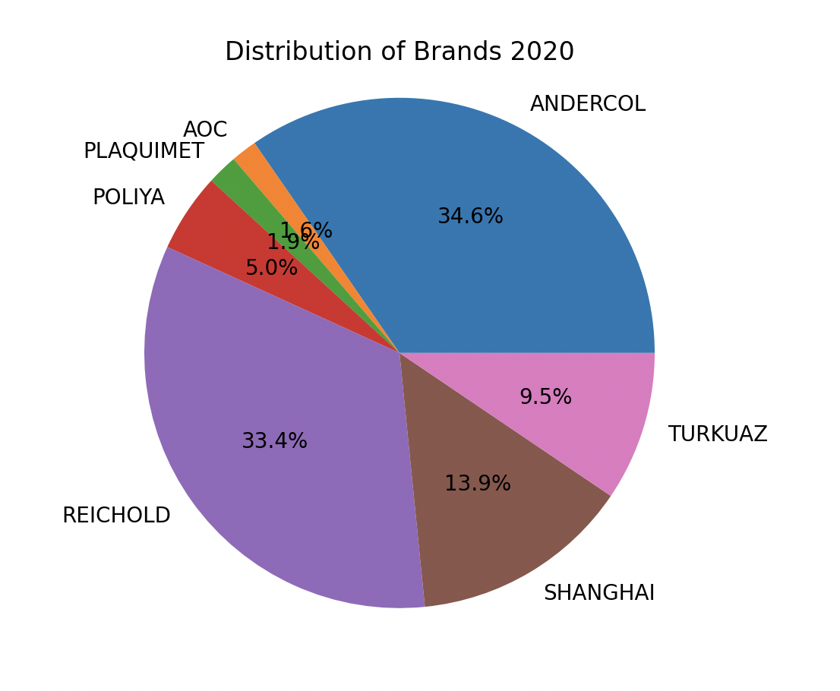
Results: Graphs from the clean data
Total Polyester market (Kg)
Bar chart showing the total amount of polyester for each year.
Total Polyester market (USD)
Bar chart showing total polyester sales for each year.
Brand Distribution in 2020
Pie chart showing the distribution of brands in 2020.

Slide 9
Learning outcomes
Python syntax and control structures.
OPP: The codes use classes and objects to organize and encapsulate related functionality
Libraries: Pandas, Matplotlib
File processing
Manipulation of DataFrame, data type conversion, data export to Excel, dictionaries, error handling
Plotting

Slide 10

Thanks a lot!
Contact
Jorge Poblete jorge.poblete.p@gmail.com

